Slide 1

Mini-Project [DBMS1&2]
TITLE : 1. SALES AND DELIVERY 2. RESTURANT
Submitted by :
1. Anmol Gupta
2. Mohammad Arsalan Siddique
3. Mohammed Aftab BS
4. Mohammed Touqeer Ar
5. Nimalsurya I

Slide 2
Problem Definition
Dataset - Dataset for SALES AND DELIVERY provided are
customer details,
market facts of organization,
orders details(id,order date,priority),
product details(category,sub-category,ids),
shipping details(order id,shipped date,shipping id,shipped mode) .
Problem Statement : By the dataset given we can find the performance of an organization through their sales data. We are getting the information regarding the sales of each products, delivery status and performance, profit or loss of each product, customers who are regular with the orders and placed maximum orders.

Slide 3
Data Set Description- Part 1
SALES AND DELIVERY
CUST_DIMEN
MARKET FACT
ORDERS_DIMEN
PROD_DIMEN
SHIPPING_DIMEN

Slide 4
Business Importance of Problem
SALES AND DELIVERY - we can understand the performance of the organisation through product sales and regular customers who placed order, profit for each product.

Slide 5

Project Flow – Question 1- Part 1
Question 1 - Find the top 3 Customers who have the Maximum number of Orders.
Provide understanding - To find the Customer details who ordered the most
Code snippet - select * from(select * , dense_rank()over(order by cnt desc) as renk from (select cd.Cust_id , cd.Customer_name , count(distinct od.Order_ID) as cnt from cust_dimen cd join market_fact mf using (Cust_id) join orders_dimen od using (Ord_id) group by cd.Cust_id , cd.Customer_name order by count(od.Order_ID) desc) as t1) as t2where renk<4;
Output :

Slide 6
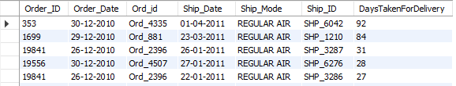
Project Flow – Question 2- Part 1
Q2 - Create a New Column DaysTakenForDelivery that contains the Date Difference between Order_Date and Ship_Date.
PU - Here we have to find the number of days for the product to get delivered.
CS - select od.Order_ID , od.Order_Date , od.Ord_id , sd.Ship_Date , sd.Ship_Mode , Ship_ID , datediff(str_to_date(Ship_Date , '%d-%m-%Y') , str_to_date(Order_Date , '%d-%m-%Y' )) as DaysTakenForDelivery from orders_dimen od join shipping_dimen sd using (Order_Id) order by DaysTakenForDelivery desc;
O :

Slide 7
Project Flow – Question 3- Part 1
Q3 - Find the customer whose order took the maximum time to get delivered.
PU - We need to find the customer whose order took the most time to deliver.
CS - select * from (select cd.Cust_id , cd.customer_Name , t1.* from cust_dimen cd join market_fact mf using (Cust_id) join (select od.Order_ID , od.Order_Date , od.Ord_id , sd.Ship_Date , sd.Ship_Mode , Ship_ID , datediff(str_to_date(Ship_Date , '%d-%m-%Y') , str_to_date(Order_Date , '%d-%m-%Y' )) as DaysTakenForDelivery from orders_dimen od join shipping_dimen sd using (Order_Id) ) as t1 using (Ord_id) ) t2 order by DaysTakenForDelivery desc limit 1;
O :

Slide 8
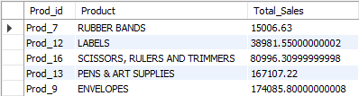
Project Flow – Question 4- Part 1
Q - Retrieve the Total Sales made by each Product from the Data (use Windows function)
PU - We need to Find the Total Sales of every Product
CS - select distinct mf.Prod_id , pd.Product_Sub_Category as Product , sum(mf.Sales)over(partition by mf.Prod_id) as Total_Salesfrom market_fact mf join prod_dimen pd using(Prod_id) order by Total_Sales;
O :

Slide 9
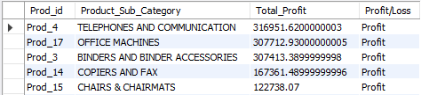
Project Flow – Question 5- Part 1
Q - Retrieve the Total Profit made from each Product from the Data (use windows function)
PU - We need to Find the Profit each Product has made till now.
CS - select * , if(Total_Profit > 0 , 'Profit','Loss') as `Profit/Loss` from (select distinct mf.Prod_id , pd.Product_Sub_Category , sum(profit)over(partition by mf.Prod_id) as Total_Profit from market_fact mf join prod_dimen pd using(Prod_id) order by Total_Profit desc ) as t1;
O :

Slide 10

Project Flow – Question 6- Part 1
Q - Count the Total Number of Unique Customers in January and how many of them came back every Month over the entire year in 2011
PU - We need to find the New customers come in January, and how many of them ordered every month over the year 2011.
CS - select 'count of repetition' as Description , count(*) from ( (select 'count' as Descirption,count ( distinct month) cnt from ( select customer_name , cd.Cust_id , year(str_to_date(Order_Date,'%d-%m-%Y')) year ,month(str_to_date(Order_Date,'%d-%m-%Y')) month from cust_dimen cd left join market_fact mf on mf.Cust_id = cd.Cust_id left join orders_dimen od on od.Ord_id=mf.Ord_id order by 1,2,3,4) t where year = 2011 group by customer_name,Cust_id having cnt>=12 order by 1)) as y union all (select 'total in january' , count(distinct cust_id) from market_fact where Ord_id in (select Ord_id from orders_dimen where year(str_to_date(Order_Date,'%d-%m-%Y'))=2011 and month(str_to_date(Order_Date,'%d-%m-%Y'))=1 ));
Solution- The output is nothing as no customer ever returned back every month in the year 2011

Slide 11
Problem Definition
Dataset- dataset for RESTURANT details are present are geolocations(location, dress code etc), user profile(including cuisine interests and choice),payment methods( user used and availability of payment in different locations), cuisines(customers order and availability in different locations),parking availability(location_wise),working hours of restaurants.
Problem Statement : by the dataset given we can find out the number of cuisine on demand in different geolocations, ratings from the customers for different cuisines and service, also the parking availability under each restaurant and payment methods offer by restaurant and the customers.

Slide 12
Data Set Description- Part 2
RESTURANT DATASET
Chefmozaccepts (Location Wise availability of Payment Modes)
Chefmozcuisine (Location Wise availability of Cuisine)
Chefmozhours4(Working Hours of Restaurant)
Chefmozparking (Parking availability at restaurants at different places)
Geoplaces2(Location Wise Summary of dress code, country, state, etc.)
Rating_final (User wise rating to the restaurants in diff locations)
Usercuisine (User had which Cuisine)
User payment (User used which payment mode)
Userprofile (Users personal details like a smoker, drink level, interest, religion, etc.)

Slide 13
Business Importance of Problem
SALES AND DELIVERY - we can understand the performance of the organisation through product sales and regular customers who placed order, profit for each product.
2. RESTURANT- we can understand how a restaurant chain works at different geo locations, cuisines are on demand, number of orders placed for different cuisines in different locations.

Slide 14

Project Flow – Question 1- Part 2
Q1 - We need to find out the total visits to all restaurants under all alcohol categories available.
PU - We need to find the Number of Customers visits under Alcohol Category
CS - Select Alcohol as Alcohol_Category , count(alcohol) as `Count of Category` from(select r.* , g.alcohol from rating_final rjoin geoplaces2 g using (placeID)) as t1 group by alcohol;
O :

Slide 15
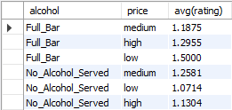
Project Flow – Question 2- Part 2
Q2 - Let’s find out the average rating according to alcohol and price so that we can understand the rating in respective price categories as well.
PU - We have to find the Average Rating and Price for each alcohol types.
CS - select alcohol , price , avg(rating) from (select r.* , g.alcohol , g.price from rating_final r join geoplaces2 g using (placeID)) as t1 group by price , alcohol order by alcohol;
O :

Slide 16
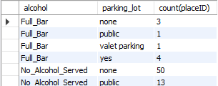
Project Flow – Question 3- Part 2
Q1 - Let’s write a query to quantify that what are the parking availability as well in different alcohol categories along with the total number of restaurants.
PU - We have to find the Parking Availability in each Restaurants and Number of Resturants for each Alcohol Category.
CS - select alcohol , parking_lot , count(placeID) from (select g.name , g.placeID , g.alcohol , cp.parking_lot from geoplaces2 g join chefmozparking cp using (placeID)) as t1 group by alcohol , parking_lot order by alcohol;
O :

Slide 17
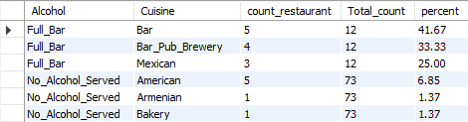
Project Flow – Question 4- Part 2
Q4 - Also take out the percentage of different Cuisine in each Alcohol type.
PU - We have to find Percentage of food in each Cuisine across each alcohol type.
CS - select * , sum(count_restaurant)over(partition by Alcohol) as Total_count , round((count_restaurant / sum(count_restaurant)over(partition by Alcohol)) * 100 , 2) as percent from (select Alcohol , Cuisine , count(placeID) as count_restaurant from(select g.alcohol as Alcohol , placeID , cc.Rcuisine as Cuisine from geoplaces2 g join chefmozcuisine cc using (placeID)) as t1 group by Alcohol , Cuisine order by Alcohol) as t2;
O :

Slide 18
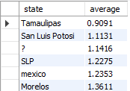
Project Flow – Question 5- Part 2
Q5 - Let’s take out the Average Rating of each State.
PR - We have to find State Wise Average Rating given by user/customer
CS - select state , avg(rating) as average from geoplaces2 g join rating_final rf using (placeID)group by state order by average;
O :

Slide 19
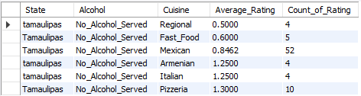
Project Flow – Question 6- Part 2
Q6 - ' Tamaulipas' Is the lowest average rated state. Quantify the reason why it is the lowest rated by providing the summary on the basis of State, alcohol, and Cuisine.
CS - select State , Alcohol , Cuisine , avg(Rating) as Average_Rating , count(Rating) as Count_of_Rating from (select g.placeID as Place_ID, g.state as State, g.alcohol as Alcohol , cc.Rcuisine as Cuisine, r.rating as Rating from geoplaces2 g join chefmozcuisine cc using (placeID)join rating_final r using(placeID) where state = 'Tamaulipas’ order by rating) as t1 group by State , Alcohol , Cuisine order by Average_Rating;
Conclusion - Based on Number of Restaurant serving Alcohol and Number of cuisines available in that state, we came to the conclusion that in the given state there is no restaurant with alcohol and also food rating for the available cuisines are comparatively lower with Regional , Fast Food Mexican being the lowest rated .

Slide 20

Project Flow – Question 7- Part 2
Q7 - Find the Average Weight, Food Rating and Service Rating of the Customers who have visited KFC and tried Mexican or Italian types of Cuisine and also their Budget level is low. We encourage you to give it a try by not using Joins.
PU - We have to find the Average weight , rating(food and service) given by customers who visited particular restaurant KFC and tried Mexican or Italian whose budget are low.
CS - select distinct u.userid, avg(weight) over( partition by u.userID) as average_weight, name, food_rating, service_rating from userprofile u join rating_final rusing (userid) join geoplaces2 g using (placeid)join usercuisine ucusing (userid) where name = 'kfc' and Rcuisine in ('mexican', 'italian') and budget='low’;
O :

Slide 21
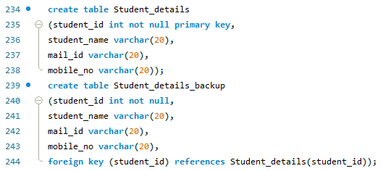
Trigger Create two called Student_details and Student_details_backup. You have the above two tables Students Details and Student Details Backup. Insert some records into Student details
.

Slide 22
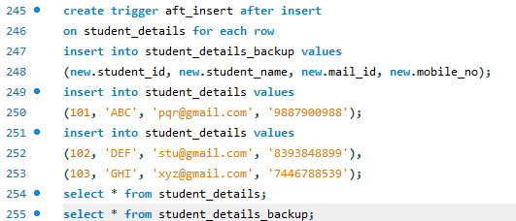

Slide 23
Major Challenge
In this section students should discuss the questions they identified and solved apart from the given set of questions.
At least 1 question per team member is expected here.
You can discuss the following points for the identified questions
Write the question
Provide understanding
Code snippet
Solution
Inference – if available

Slide 24
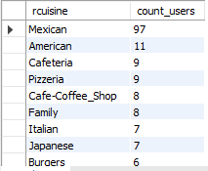
Project Flow – Major challenge
Question 1- count the no of distinct users for each type of cuisines
Code snippet- select rcuisine,count(distinct(userID)) as count_users from usercuisine group by 1 order by 2 desc

Slide 25

Project Flow – Major challenge
Question 2- how many orders got delivered through air mode
Code snippet- select count(ship_mode) from shipping_dimen where Ship_Mode like '%air%‘

Slide 26

Project Flow – Major challenge
Question 3- count the number of of subcategories present for each product category
Code snippet- select Product_Category,count(Product_Sub_Category) from prod_dimen
group by 1

Slide 27
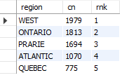
Project Flow – Major challenge
Question 4- find out the top 5 region in which most number of orders placed
Code snippet- select * from (select *,row_number()over(order by cn desc) rnk from (select region,count(Ord_id) cn from market_fact mfjoin cust_dimen cd on cd.Cust_id=mf.Cust_idgroup by 1)t)tt where rnk<=5

Slide 28

Project Flow – Major challenge
Question 5- find out the customer segment which orders the most
Code snippet- select * from (select *,dense_rank()over(order by cn desc) rnk from (select Customer_Segment,count(Ord_id) cn from market_fact mfjoin cust_dimen cd on cd.Cust_id=mf.Cust_idgroup by 1)t)tt where rnk=1

Slide 29
Thank You !!!....

